Slide 1
Python Course for Physicists (And everyone else!) Chunk 4: Lists and Tuples
By Jonathan Bollig
08.10.2025

Slide 2


Live Coding: Structuring More Data in a Single Variable: Lists
How we can do it now:
A better way to do it: → A „list“
Can contain anything:
Even a list in a list:

Slide 3
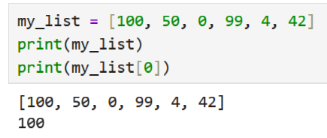
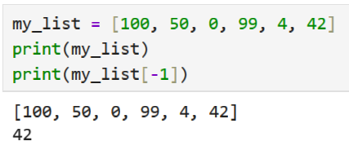
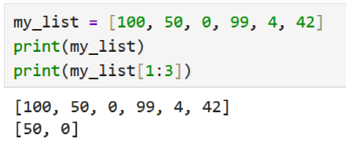
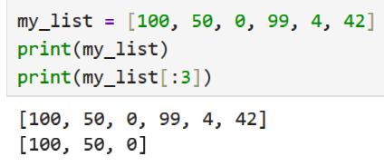
Live Coding: Slicing / Indexing
Access single values in a list: [index]
→ 0 – Indexed!
Counting from back: [-index]
→ 1 – Indexed!
Accessing multiple values: [start_index : end_index]
→ Start is inclusive
→ End is exclusive
From beginning / end: [start_index:] / [: end_index]

Slide 4
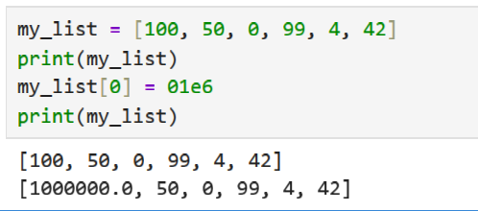
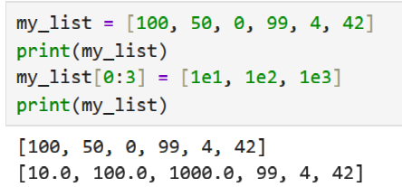
Live Coding: Changing Lists:
Sliced / Indexed parts can be altered:

Slide 5
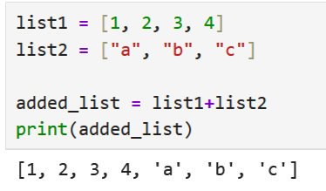
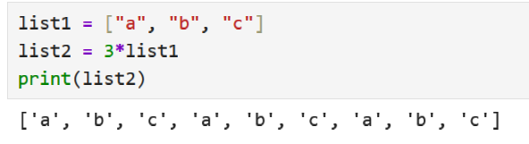
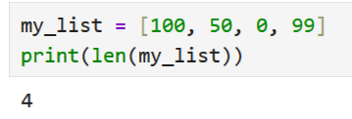
Live Coding: Arithmetic Operators on Lists:
“+”: concatenate →
“*”: repeat (with integer) →
Get length of list:

Slide 6
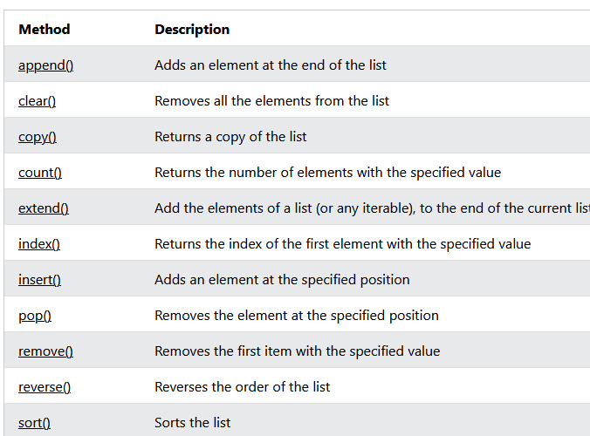
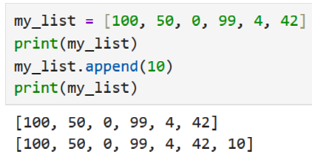
Live Coding: General Functions on Lists
Mostly unimportant for us, but good to know.
Only important:
→ append() :
[https://www.w3schools.com/python/python_ref_list.asp]

Slide 7
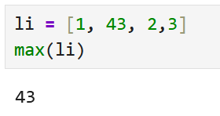
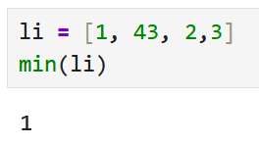
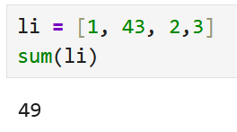
Live Coding: Functions on Numeric List:
If list only contains numbers:
max():
min()
sum()

Slide 8
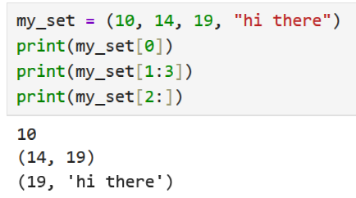
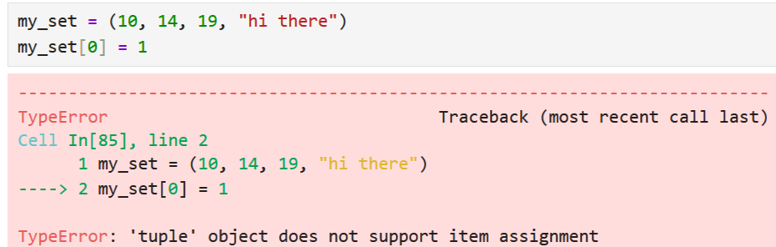
Tuples: Similar to Lists, but less flexible
Created with “()“ instead of “[]”
Accessed similarly:
However: Cannot be changed:
For the nerds: Lists are mutable type, sets are unmutable.

Slide 9
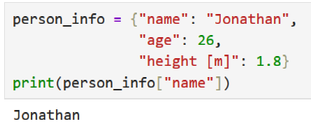
Dictionaries
Often used in python
Not so important for scientific purposes (at least at the beginning)
Short intro: Like lists, but with named indices:
Another type of data: „sets“, haven‘t used them once.

Slide 10
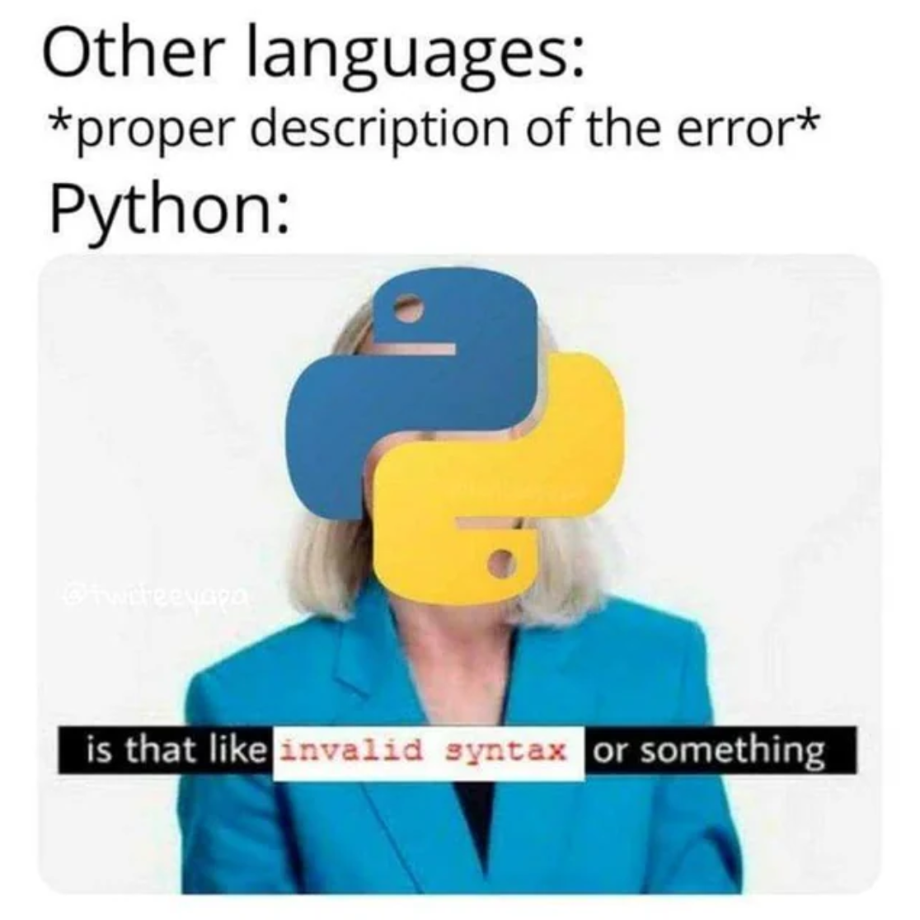
Good Luck with your Tasks ☺
[https://www.reddit.com/r/ProgrammerHumor/comments/j2kanm/python/]

